Slide 1
Sprint Planning / Execution Screen Shots

Slide 2
Agile –Scrum Vs Traditional
Deploy at the end of every sprint
Test at the end of every sprint

Slide 3
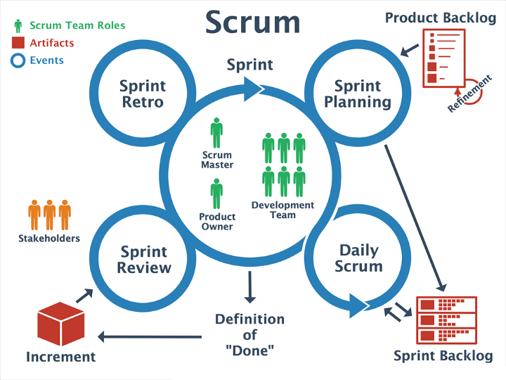
Agile – Scrum Components
Product Roadmap
Project blueprint
All the requirements written as backlog items
Epics
Features to big to be completed in a single sprint (Your Projects)
Big “Story”
Example: Dog park app
Story
Features within the epic
Example: login page
Tasks
Elements of the “Story”
Example: Program hashing algorithm for password entry
Example: Queue database for username entry
Example: Change image of login icon

Slide 4


GitHub\Gitlab
GitHub
Bought by Microsoft in 2018
Utilizes git code tracking software
Gitlab
Started in 2011
Utilizes git code tracking software

Slide 5
Git

Slide 6

Git Utilization for Team Work (Agile Coding)
Log into GitHub and start an account
Once Signed in hit the plus button on the top of the screen
Click Repositories from the dropdown
Click Create new repository

Slide 7
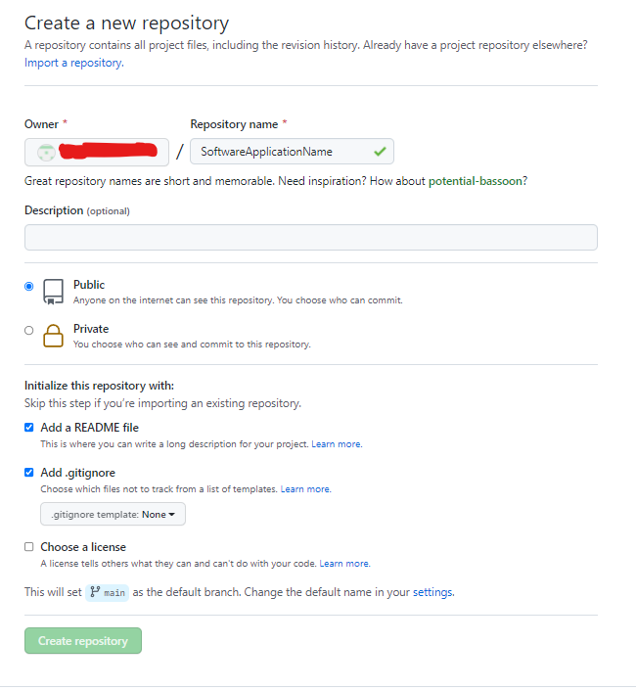
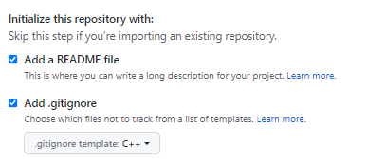
Git Utilization for Team Work (Agile Coding)
When you click create a new repository the screen in Fig1 appears
Select Public or Private
Select “Add a readme file”
Select add a “gitignore”
Gitignore option has a dropdown for language specific
Fig2
Fig1

Slide 8
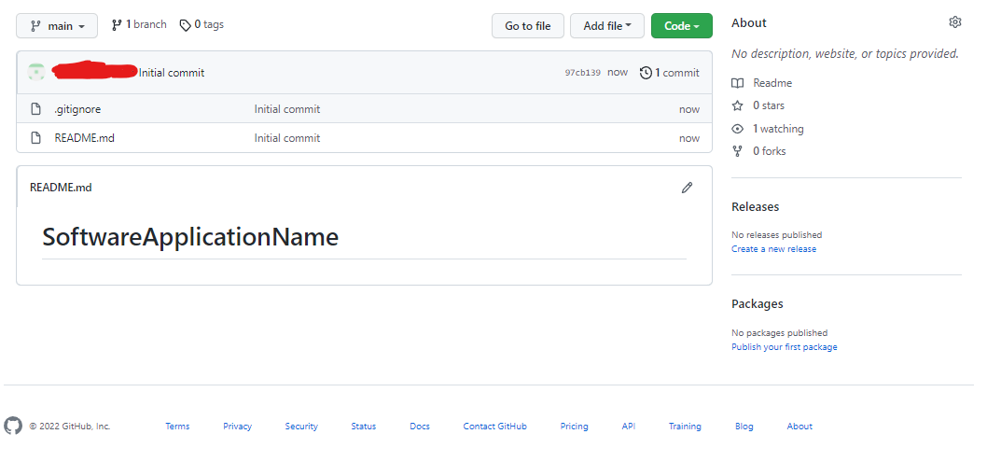
Git Utilization for Team Work (Agile Coding)
Your initial repository will be bare, only a readme.md and a .gitignore file
Notice this counts as the initial commit

Slide 9
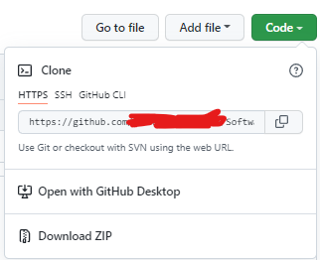
Git Utilization for Team Work (Agile Coding)
Click the green clone button
Copy the HTTPS address
Do not “Branch” or “Fork” the repository

Slide 10
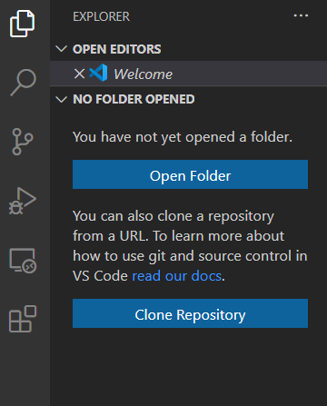
Git Utilization for Team Work (Agile Coding)
When you open visual studio code (VS Code) you will see a git icon in the left pane
You might have to install git on your machine follow the instructions provided after clicking the icon
Click clone repository

Slide 11
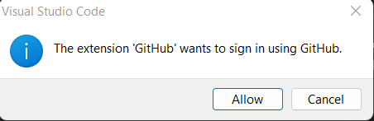
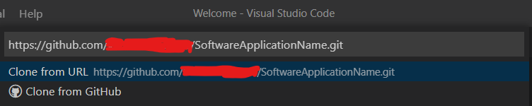
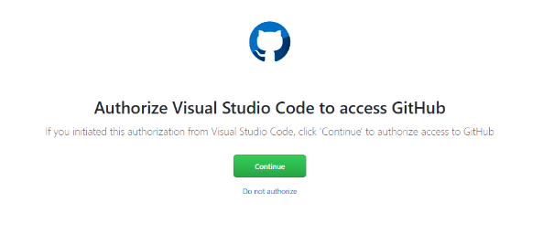
Git Utilization for Team Work (Agile Coding)
Fig2
Fig1
Fig3
In the open space paste your repository URL (Fig1)
Click clone GitHub (Fig1)
You may get an extension warning from GitHub (Fig2)
You may also have to authorize GitHub (Fig3)
This will clone your repository

Slide 12
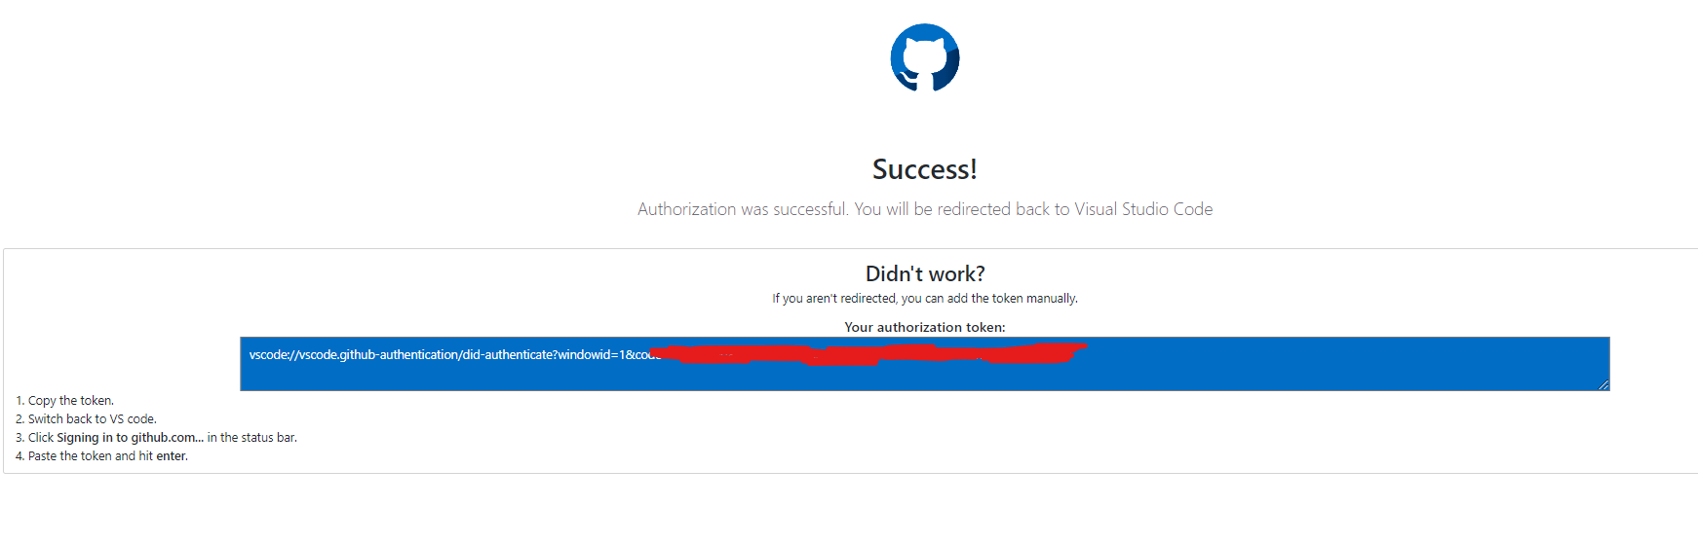
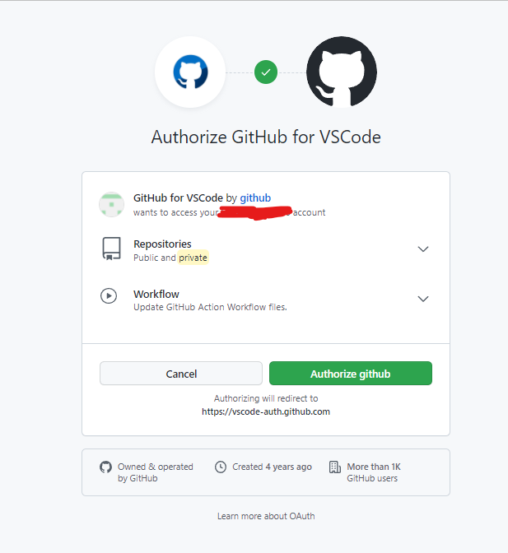
Git Utilization for Team Work (Agile Coding)
You must Authorize GitHub for VS Code

Slide 13
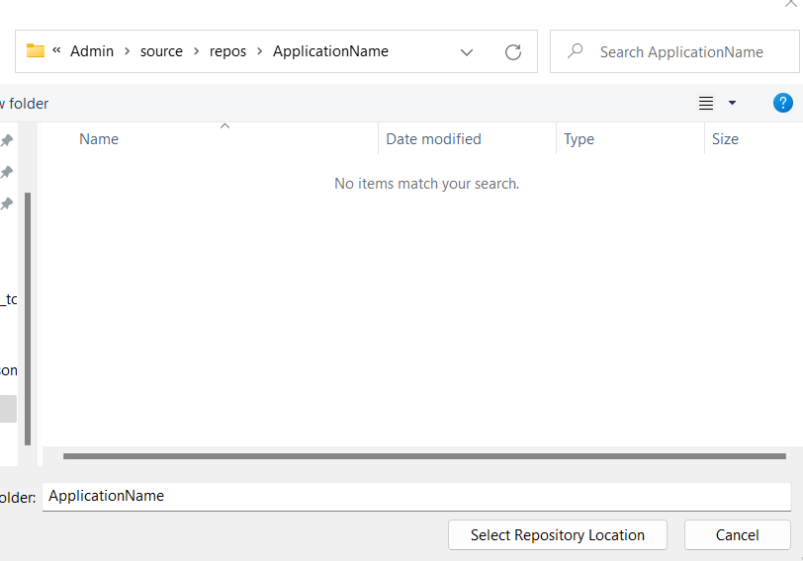
Git Utilization for Team Work (Agile Coding)
Select the folder location of your repository (Where your code will reside)
In windows the default for Visual Studio is C:\\users\<user name>\Source\repos\

Slide 14
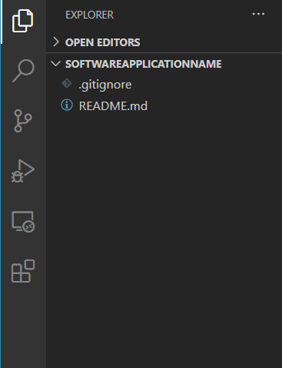
Git Utilization for Team Work (Agile Coding)
When you open visual studio code (VS Code) you will see your repository
.gitignore and README.MD will appear

Slide 15
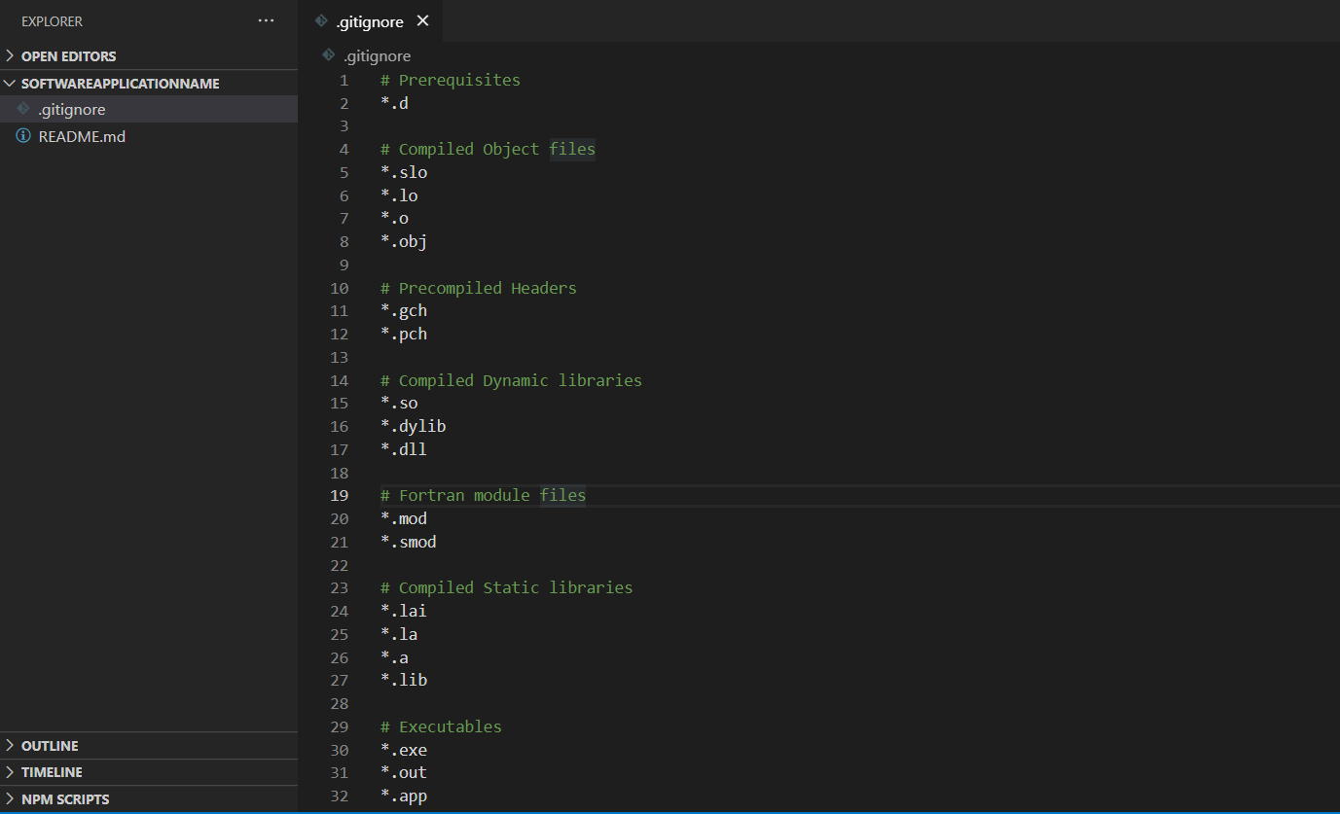
Git Utilization for Team Work (Agile Coding)
The example in Fig1 shows the default exemptions for C++ files
Anything in the .gitignore will be omitted from the repository
Object files, executables, some other project files specific to the developers environment should be left out.
* is used as a wildcard to omit every instance of the filetype
Fig1

Slide 16
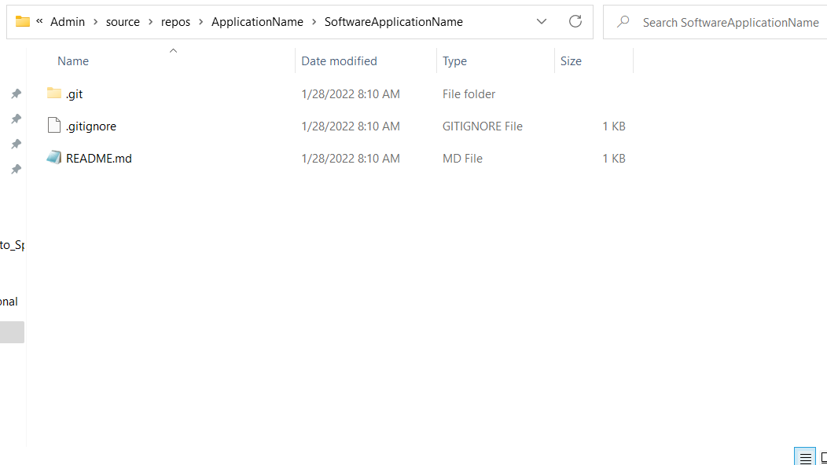
Git Utilization for Team Work (Agile Coding)
If you use the file explorer to look at the repository folder you will see a hidden git folder
In windows you might have to change the folder settings to view the folder
This holds all the git information for the repository
If the git folder is deleted any code history not committed will be lost

Slide 17
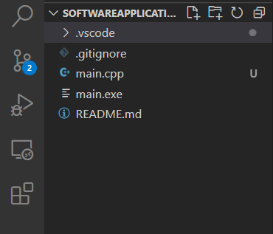
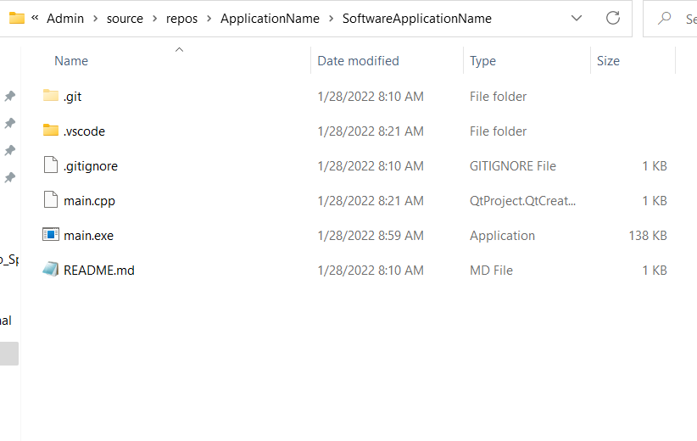
Git Utilization for Team Work (Agile Coding)
I've added a main c++ file and compiled it
VS code is displaying the new files
You can also see the new files in the file explorer
Click on the git icon to see what is changed

Slide 18
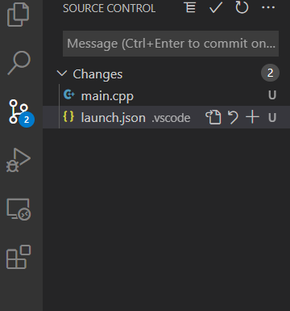
Git Utilization for Team Work (Agile Coding)
The repository tab shows two changes a main.cpp(Code) and a launch.json(Dev Environment file)
Why isn’t the new executable file displayed as a change?

Slide 19
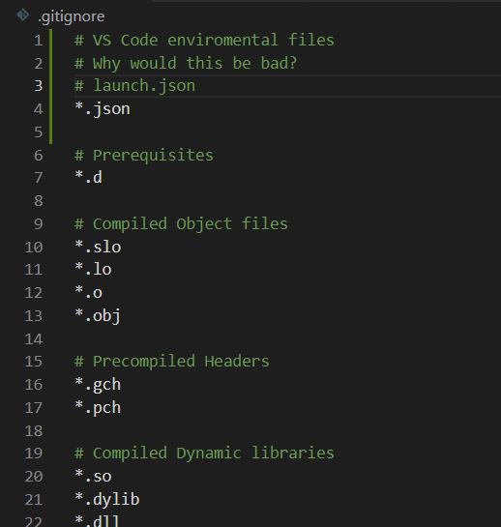
Git Utilization for Team Work (Agile Coding)
I've added *.json to the .gitignore file, launch.json should no longer show up as a change and will be ignored in the git
Why would using the wild card * be bad?
What could we do to mitigate the * wild card problem?

Slide 20
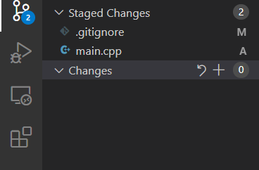
Git Utilization for Team Work (Agile Coding)
If we go back to the repository tab in VS code we still see two file changes( .gitignore, main.cpp)
Why is .gitignore showing as a changed file now?
(M) – Files that have been modified
(A) – New files that have been added to the repository
Right click on the files to “stage” them they will move from the changes to the staged area

Slide 21
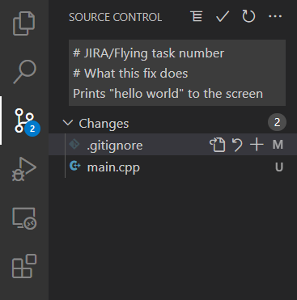
Git Utilization for Team Work (Agile Coding)
After you have a stable version you are ready to commit your code changes to the repository
Until now all your changes have been to your local repository
You must provide a statement when you commit
I want to see your JIRA#
This commit should be directly related to a agile –scrum task item and story
I also want to see a brief statement on what the code change was\
I DO NOT want to see a messy repository all changed need to stay local until they are stable enough to be committed to the repository
Git is not a save button do not over use git commits

Slide 22
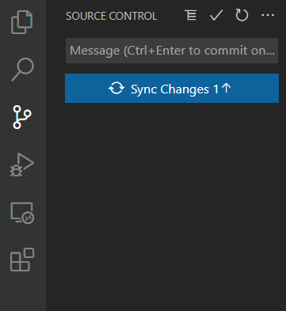
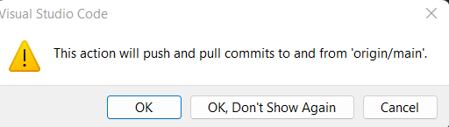
Git Utilization for Team Work (Agile Coding)
When you commit the commit is still local to your repository
To send to the online repository you must “push” to the remote repository
You can do this by utilizing the “sync changes” feature in VS code
VS code will warn you of what you are about to do
Take pride in your work! Do not push unfinished or sloppy work to the remote repository
Fig1
Fig2

Slide 23
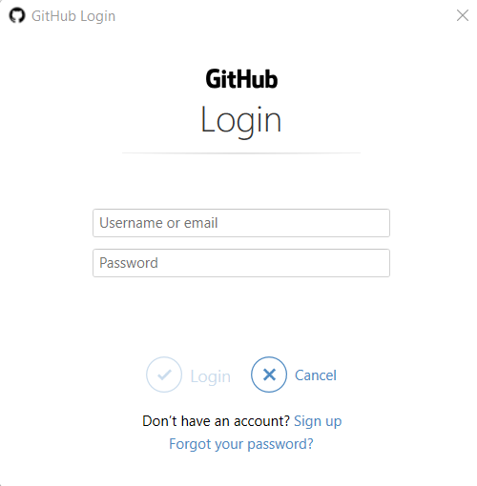
Git Utilization for Team Work (Agile Coding)
You may be required to enter credentials based on how your repository is set up

Slide 24
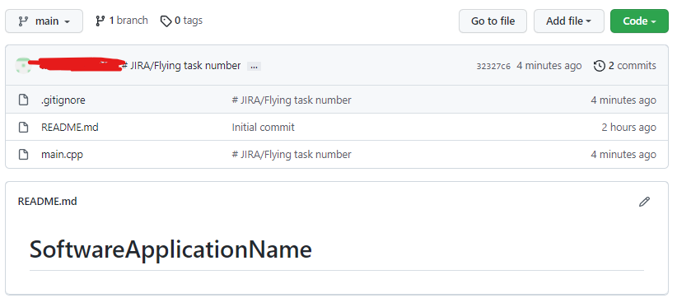
Git Utilization for Team Work (Agile Coding)
After a “push” you will see your code changes in the remote repository (github\gitlab.com)
Notice there are now 2 commits tracked in the remote repository

Slide 25
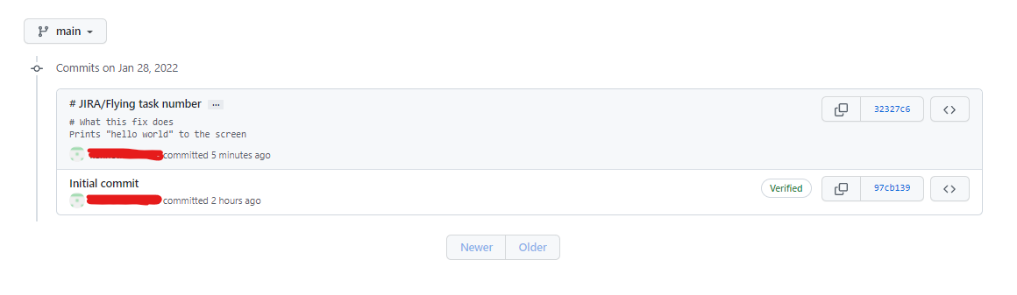
Git Utilization for Team Work (Agile Coding)
Clicking on the 3 dots next to the commit will display the commit comments
The comments are important for your team and anyone maintaining the code to quickly find a change
This will be essential for team code reviews and referencing code changes to JIRA\Flying

Slide 26
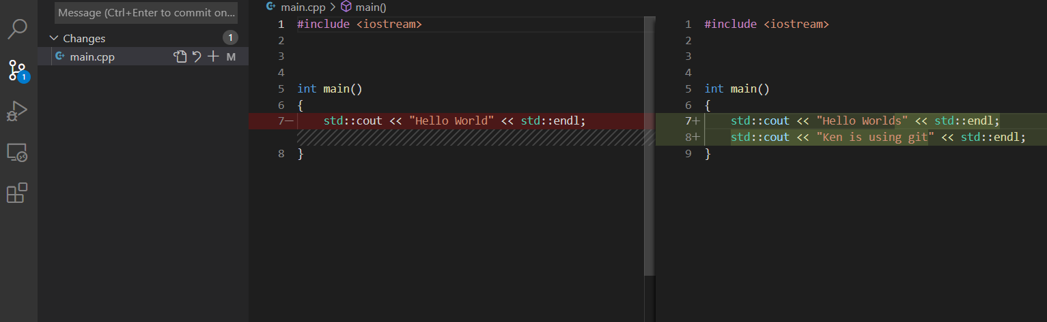
Git Utilization for Team Work (Agile Coding)
Most modern IDE’s have git integration
In VS code you can click on the changed file in the repository tab and it will show what changed in the file
Green Highlight – New code
Red Highlight - Removed code or old
Spend time reviewing the changes before staging the changed files for commit

Slide 27
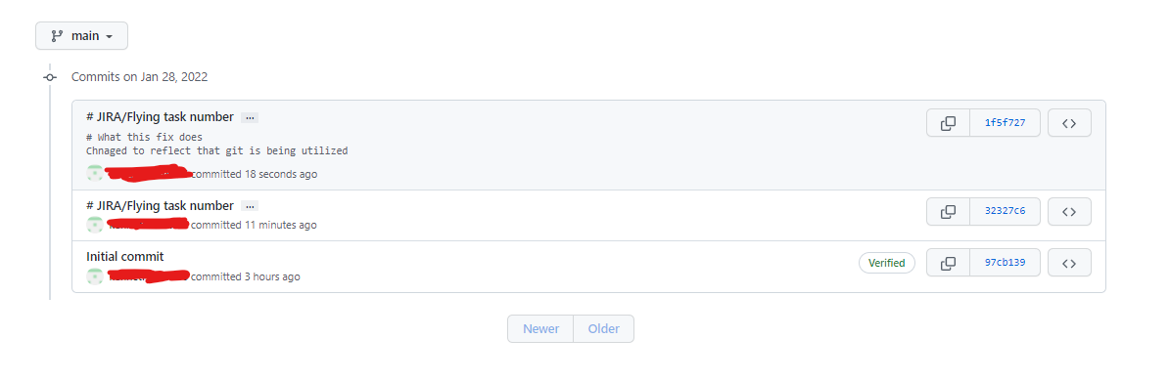
Git Utilization for Team Work (Agile Coding)
My new commit is showing in the remote repository I now have 3 commits
All of them are listed in the order they were committed
All your commits should be unique to a JIRA\Flying task # and story and dated the same date as your sprint planning indicated!

Slide 28
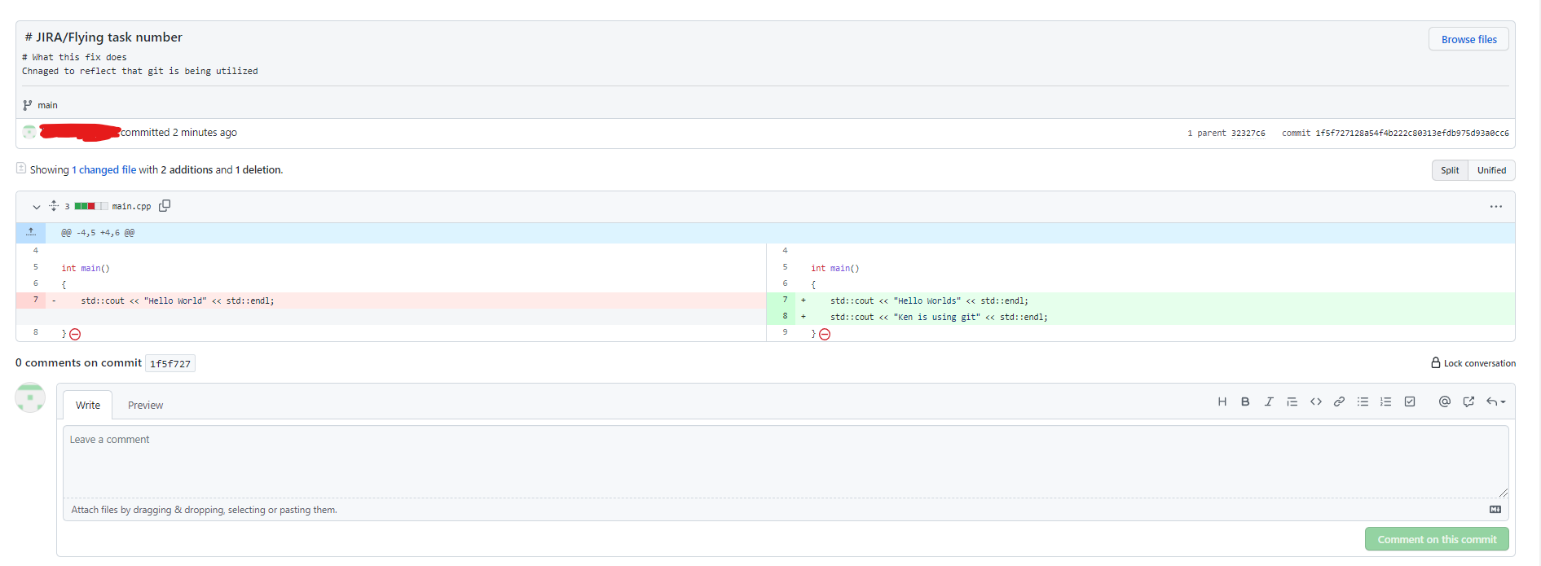
Git Utilization for Team Work (Agile Coding)
If you click on the commit in GitHub\Gitlab you will be able to see the code changes made
Your team must do a group code review at the end of the sprint
Each commit should be reviewed by the team and the developer should explain how the code was tested

Slide 29
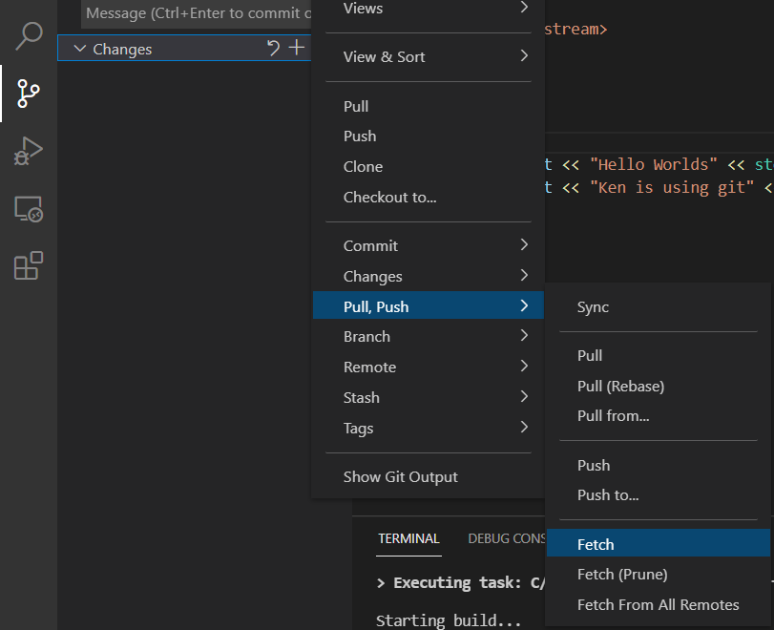
Git Utilization for Team Work (Agile Coding)
At the beginning of the next sprint you should fetch the teams changes (Keeping your local repo up to date)
Click on the three dots next to changes
In the dropdown select pull, push and then fetch
Fetch will retrieve all the latest commits from the remote repository
This will keep your repository up to date

Slide 30
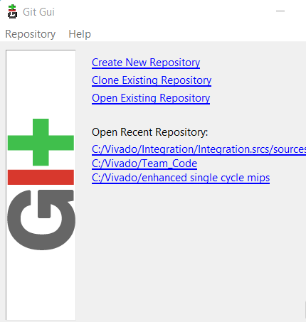
Git GUI
Another popular open source git program is git GUI
Git GUI is a simple no frills repository manager
Git GUI allows you to clone a repository and maintain it
This lets you use any IDE that doesn’t have an integrated git feature

Slide 31
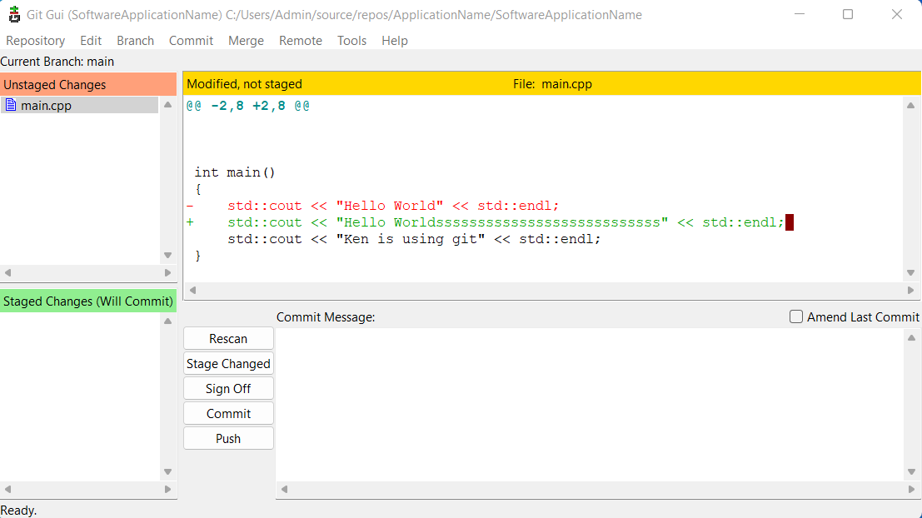
Git GUI
I opened our existing repo, that I had made changes too
Git GUI will show changes in the upper corner
Select the changed files to see what was changed
(Green = New, Red = Removed)

Slide 32
Git GUI
Rescan – Refreshes the folder looks for new changes
Stage changes – Will stage all changes
Commit – Requires a “Commit Message” Commits the changes to the local repo

Slide 33
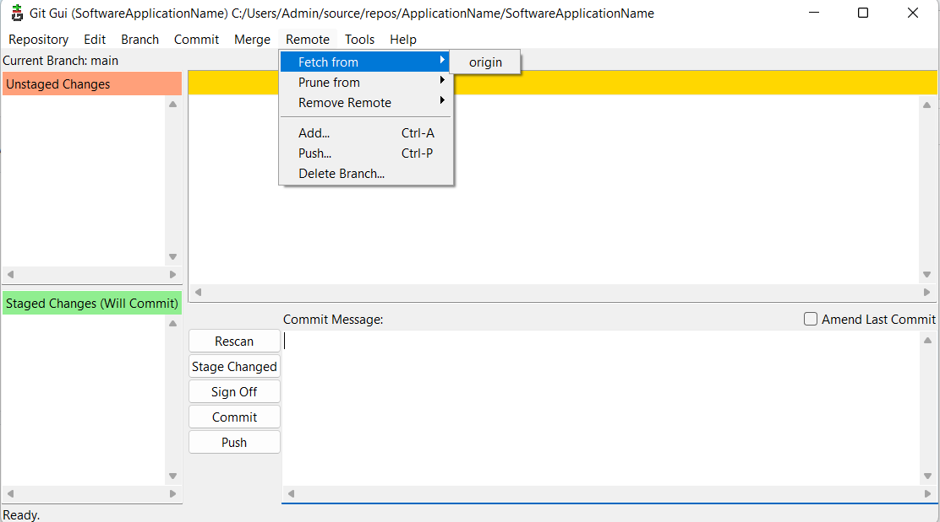
Git GUI
Push – Will send your commits to the remote repository
Fetch – Will retrieve your teams code commits

Slide 34
Git Review
Stage
Stage
Review local code changes
Stage the changes
Commit
Package the staged changes into a single commit
Clear comments reason for this commit (code change)
Push
Share your changes with your team
Push your local repository to the remote repository for team code review
Fetch
Fetch the latest and greatest distribution
Ready for next development cycle (Sprint)
Fetch
Git
Commit
Push

Slide 35
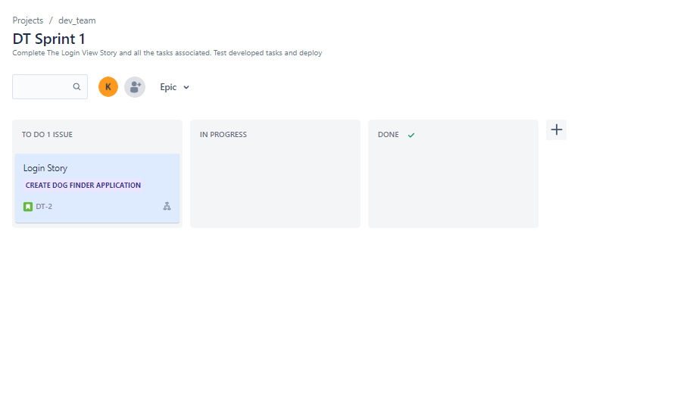
Sprint Planning Screen Shots
All items are in TO DO
No tasks should already be started or completed
This screen shot lets me know what stories are planned for the sprint

Slide 36
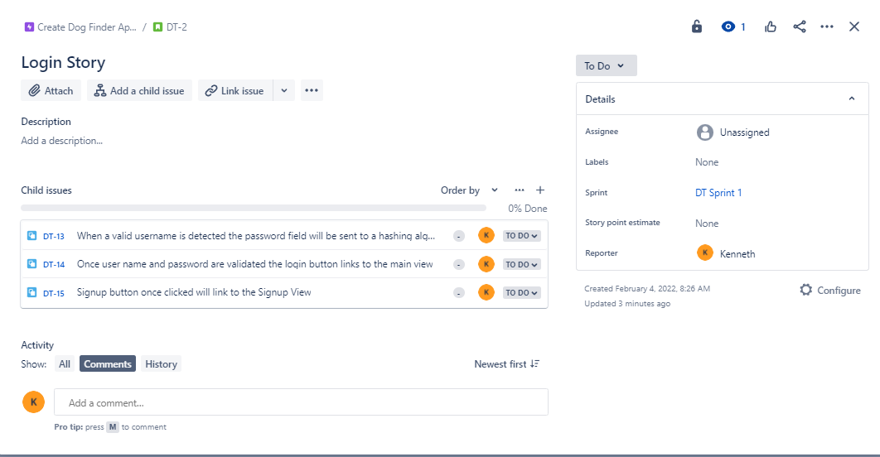
Sprint Planning Screen Shots
Detailed View of who is assigned each task
ALL members must be assigned a development task that is applied to the code repository in git
Research, setup, cleanup, project management and recording while valuable is not development
Submit a list of team members and their JIRA/Flying Doughnut handles or pictures….

Slide 37

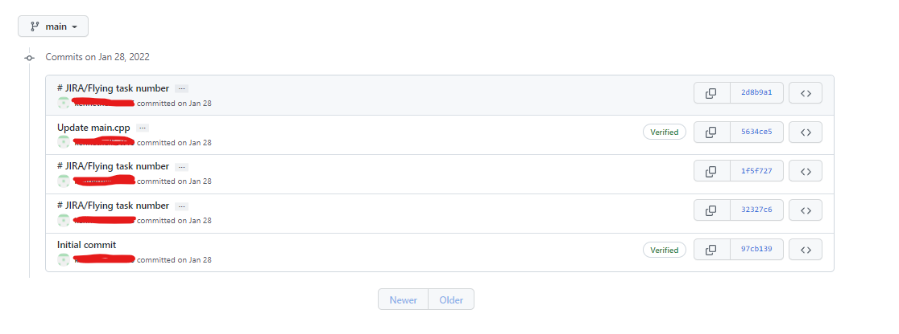
Git Screen Shots Execution Report
Click on the clock commits icon
Shows developers name, date of commit and JIRA/Doughnut task
Submit a list of team members names and their git handles

Slide 38
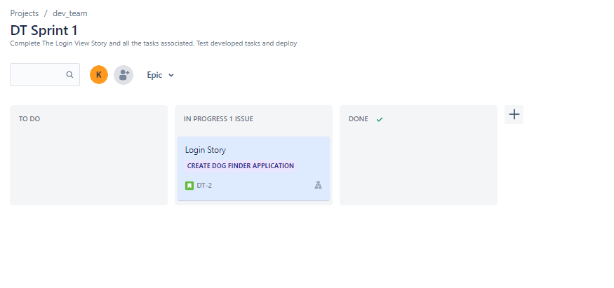
JIRA Screen Shots Execution Report
This story shows still in progress, which is ok
Sometimes stories take several sprints to complete

Slide 39
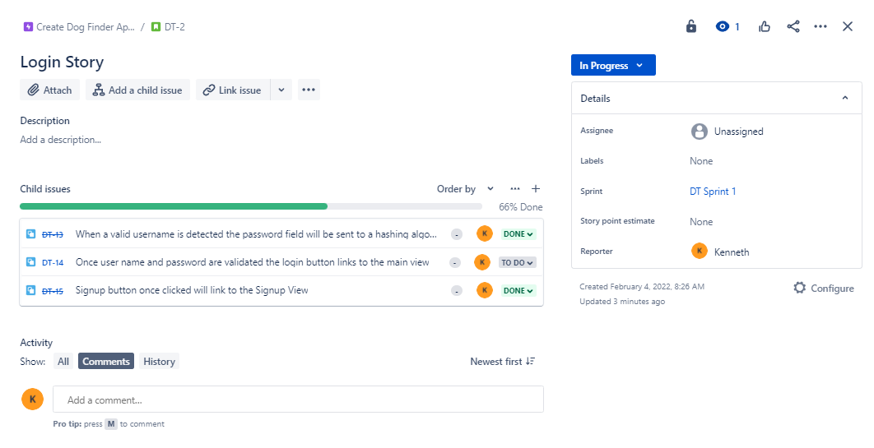
JIRA Screen Shots Execution Report
Mark the tasks done that are developed tested and in the git
Leave slipped tasks marked as TO DO
Its ok to have tasks slip however it should not be the standard

Slide 40

Clean Up
Reminders
Speak to definition of done*
Speak End of Sprint Testing*

Slide 41

Questions??
Next Lecture
Readme.MD
JIRA Review

